Slide 1

Treating and Pruning
forecasting model selection and combination
using prediction intervals
組員: 經碩一 劉軒宇
經碩一 游棫棨
經碩一 林鼎文

Slide 2
https://www.ypppt.com/
Content
1
Introduction
2
Methods
3
Empirical Investigation
4
Conclusion

Slide 3
01
Introduction

Slide 4
Introduction
ETS and Bagging have made great contributions to forecasting .
However, most of the traditional methods in the past only considered the PF not prediction interval (PI).
M4 competition was the first to provide PI for their PF, but in the end only 20 forecasters provided valid PI.

Slide 5
Treating and Pruning
Treating
To enhancing ETS model predictive power.
Pruning
To improve the accuracy of both point forecasts and prediction intervals in forecast combination methods.

Slide 6
Model selection in most or traditional automated ETS
Solution
Use “Treating” and “Pruning”
to reduce the odds of selecting formulations that will lead to inaccurate forecasts, thus enhancing the overall accuracy of automated ETS procedures.
To minimization of one or more information criteria.
Despite the benefits arising from this procedure, such as avoiding overfitting, the selected model occasionally leads to unstable forecasts

Slide 7
Pretreatment
The goal is to collect the PI provided by competing models and check for anomalous behavior in the ensemble.
Low values for most information criteria but are not selected.
Therefore , they need pretreatment to help enhance the prediction.

Slide 8
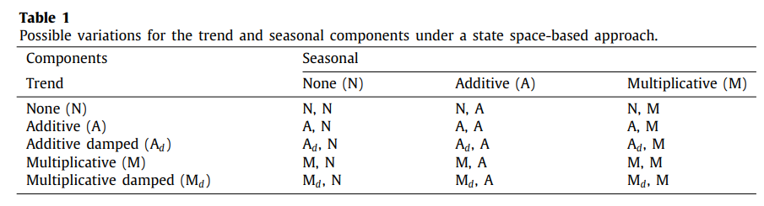
According to the taxonomy proposed by Pegels and further extended by Gardner Jr.,there are 30 standard formulations of ETS,the trend and seasonal components are depicted in Table 1 and the error term can also vary between additive or multiplicative.

Slide 9
Bootstrap Model Combination (BMC)
Bagging using PF not PI for prediction may generate the uncertainty .
BMC specifically addressing this source of uncertainty.
Conclusion:
BMC achieves better results than Bagged.BLD.MBB.ETS and Boot.EXPOS in most cases.

Slide 10
02
Methods

Slide 11
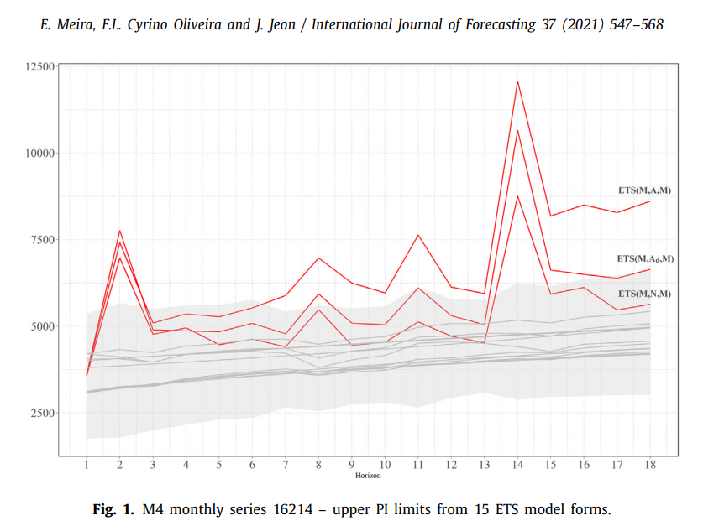
Treating in ETS model selection
The shaded area represents the bound aries/range of the ± 1.5 × IQR.
ETS ( M, N, M )
ETS (M, Ad, M) are discarded
ETS ( M, A, M )
left with 12 competing ETS forms for model selection.

Slide 12
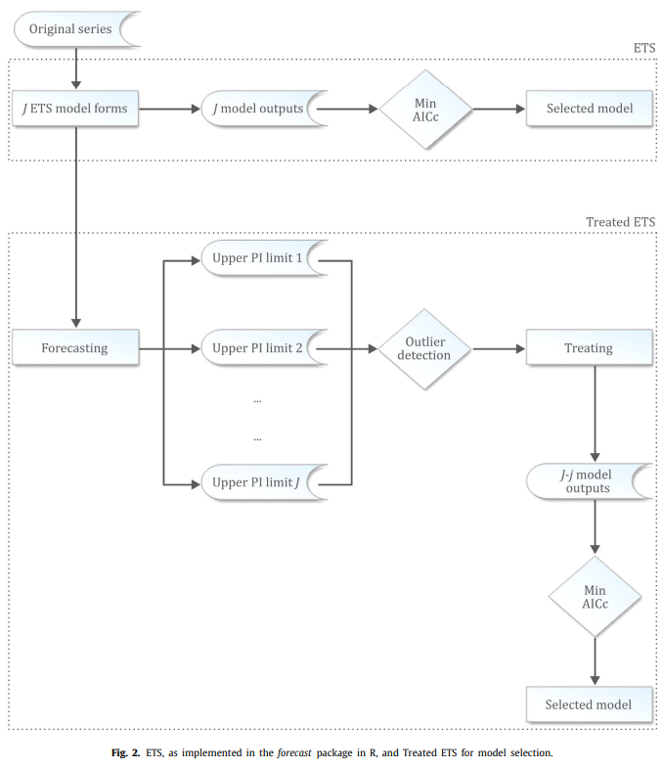
J 代表 ETS 中默認估計
的15種模型形式
(- j )
代表處理過程中所
丟棄之模型形式
Why not “PF”?
PI 代表預測區間

Slide 13

Treating in ETS model combination
“AICc weighted average” variation
weighted averages of PFs from all smoothing models investigated, with weights corresponding to the differences from each model AICc to the minimal AICc model

Slide 14
Pruning in model combination
The rationale behind pruning is quite similar to treating. The main difference is that now we aim at subsetting the pool of forecasts to be combined.
A feature selection strategy to improve the quality of PIs and PFs of any forecast combination method.
Discuss in the Bagged.BLD.MBB.ETS method proposed by Bergmeir et al. (2016) ; and the BMC devised by Petropoulos et al. (2018).

Slide 15

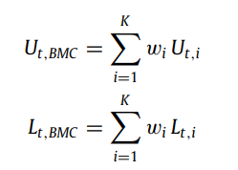
Generate Prediction intervals
using the median to generate the corresponding PIs in Bagging
As for BMC, we take a weighted average of the PIs generated from applying the ‘unique’ ETS model forms on the original data

Slide 16
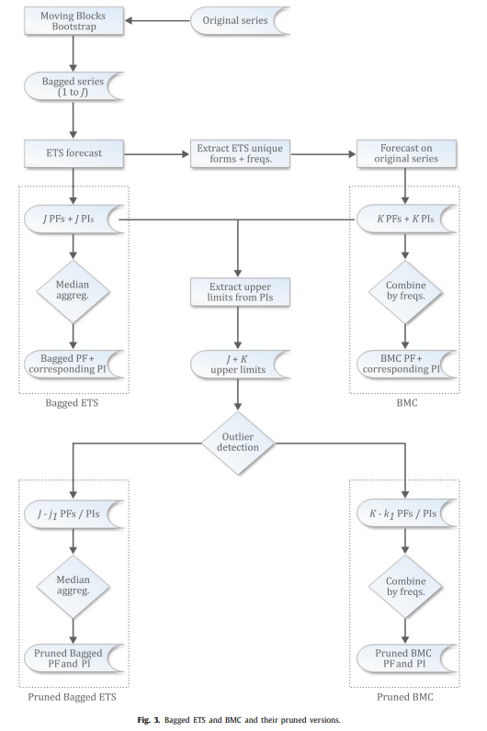

Slide 17
03
Empirical Investigation

Slide 18
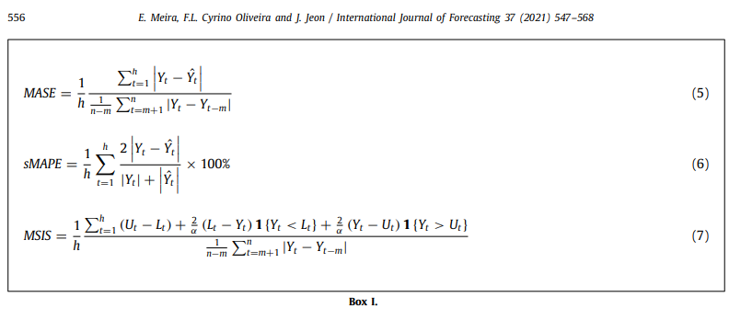

Slide 19
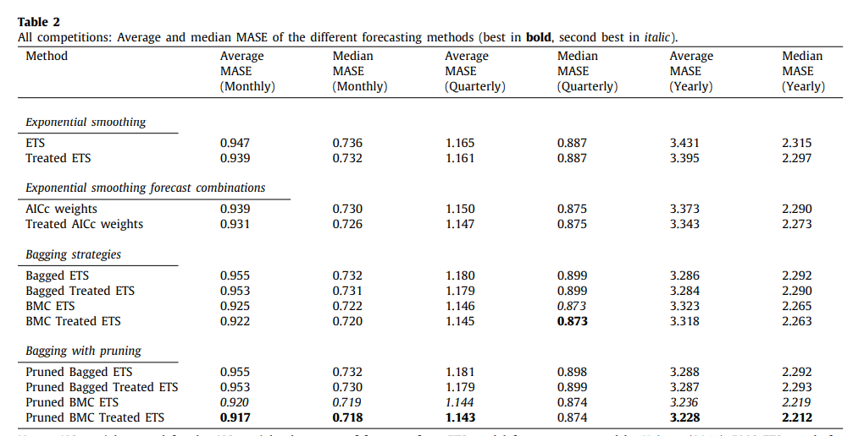



Slide 20
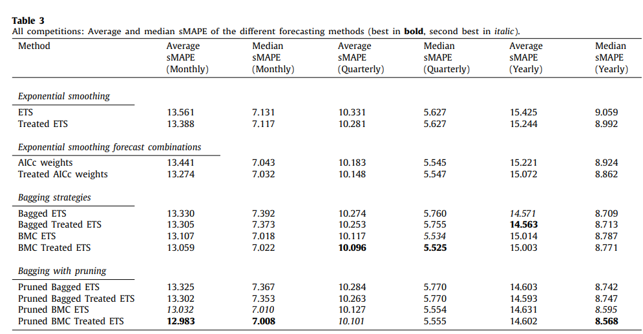

Slide 21
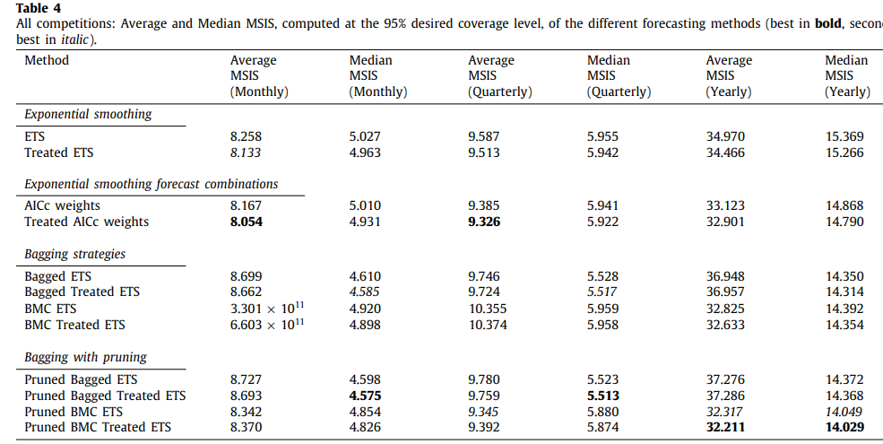

Slide 22
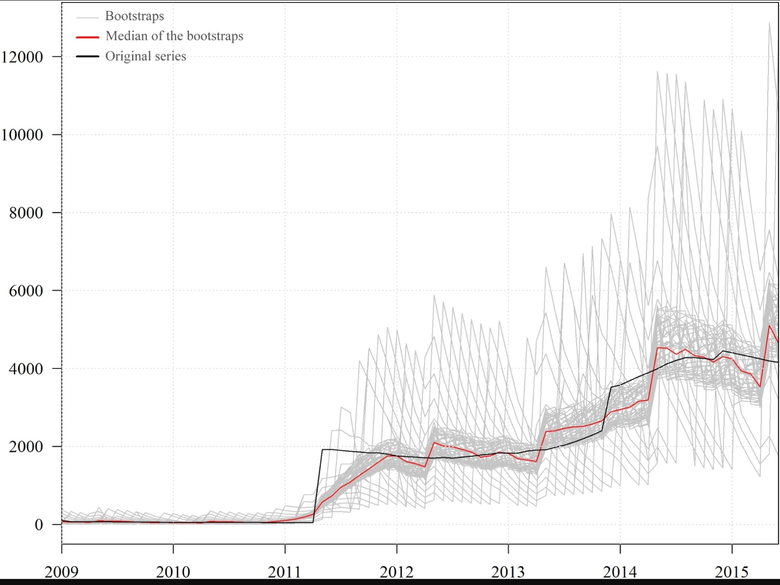

Slide 23
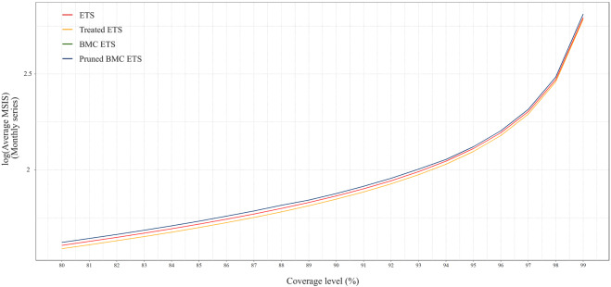

Slide 24
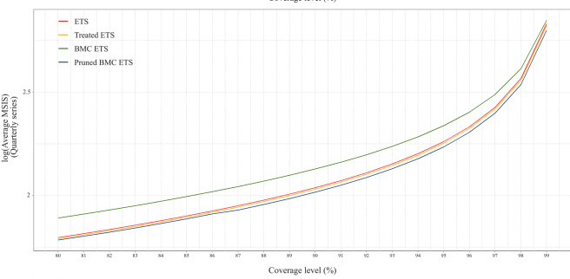

Slide 25
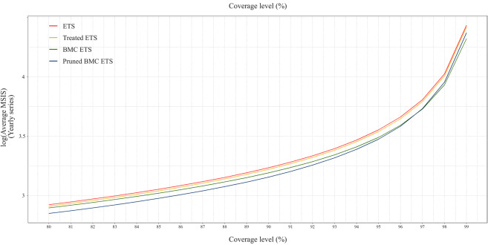

Slide 26
4.2. Empirical findings per competition
we summarize the PF and PI results per competition considered.
The average and median MASEs across M1, M3 and M4 are depicted in Table 6. The average and median MAPEs are given in Table 7. Finally, the average and median MSISs are presented in Table 8.
The treated versions of ETS and AICc weights are superior than the original methods.
Bagging approaches benefit from the use of Treated ETS as forecasting method for the bootstraps, in lieu of the traditional ETS.
Pruning usually improves the accuracy of Bagging, particularly BMC, approaches.

Slide 27
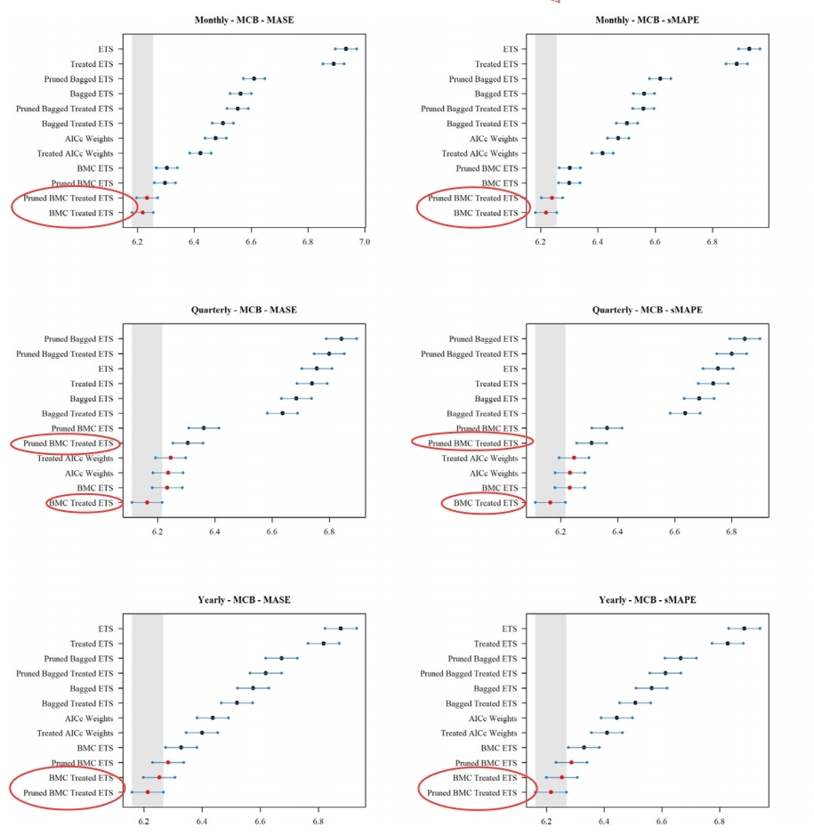
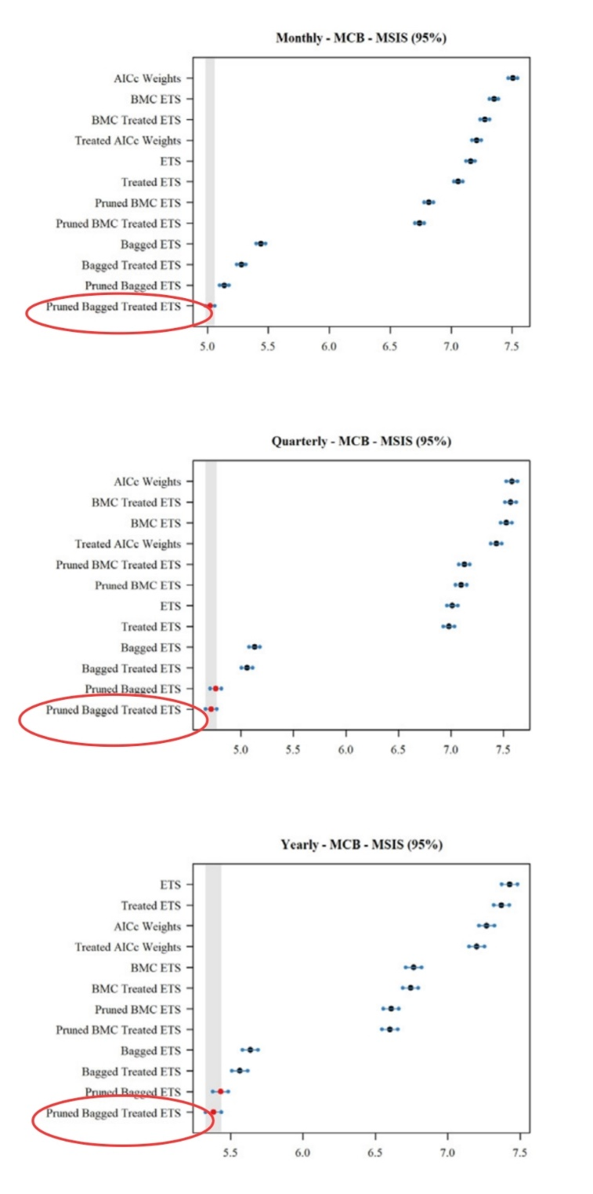

Slide 28
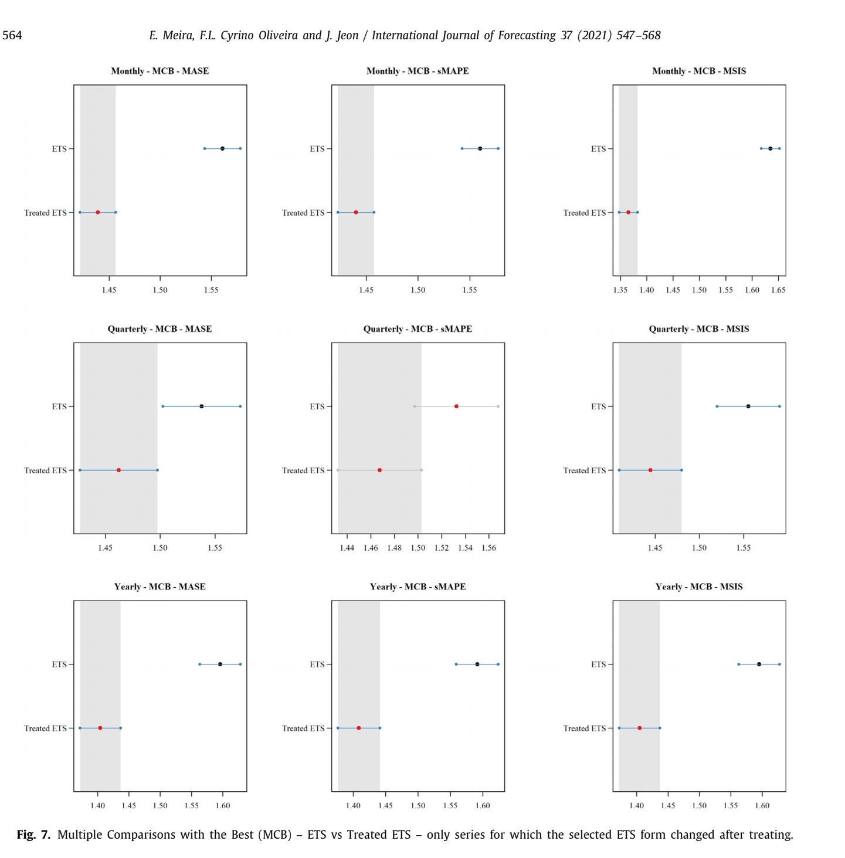

Slide 29
4.4. Relative performance on the M3 and M4 competitions
Overall, the proposed approaches provided competitive PFs when compared to the best methods in M3 and competitive PIs when compared to the best methods in M4.
Against M4 Competition , approaches were not as competitive, in terms of PFs, as the best methods in that competition.
Treating and pruning were worth recalling that the overall accuracy of pruning in the cases considered is restricted to how good Bagging strategies perform in practice.

Slide 30
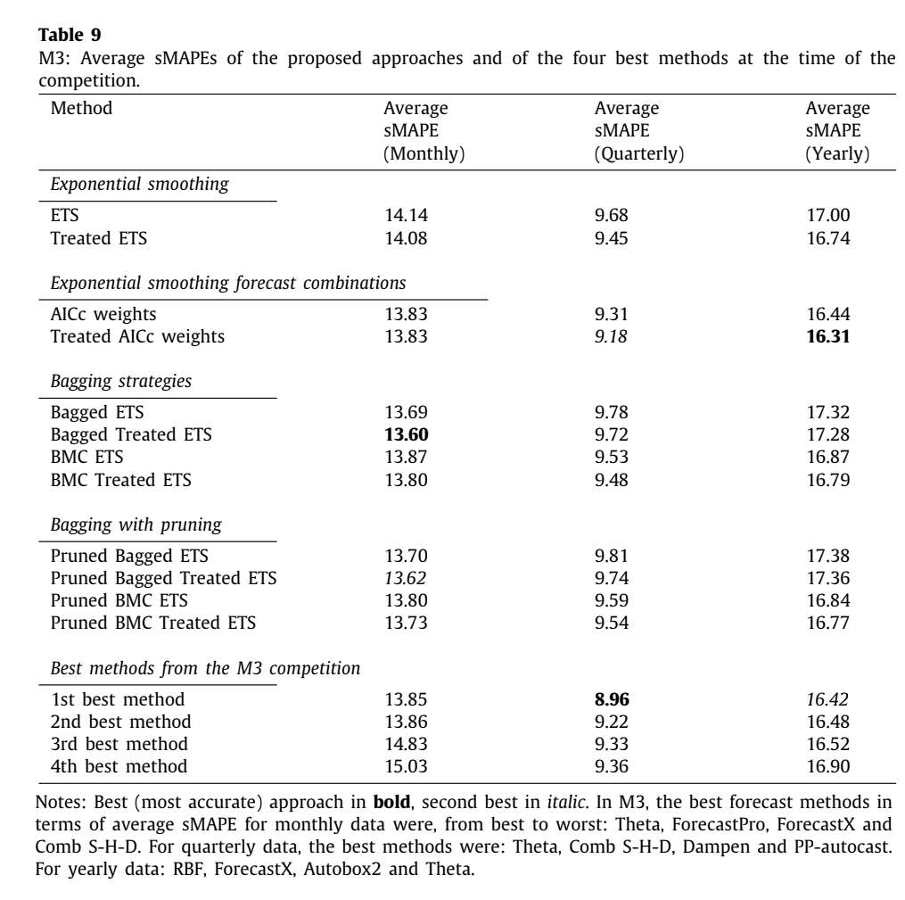

Slide 31
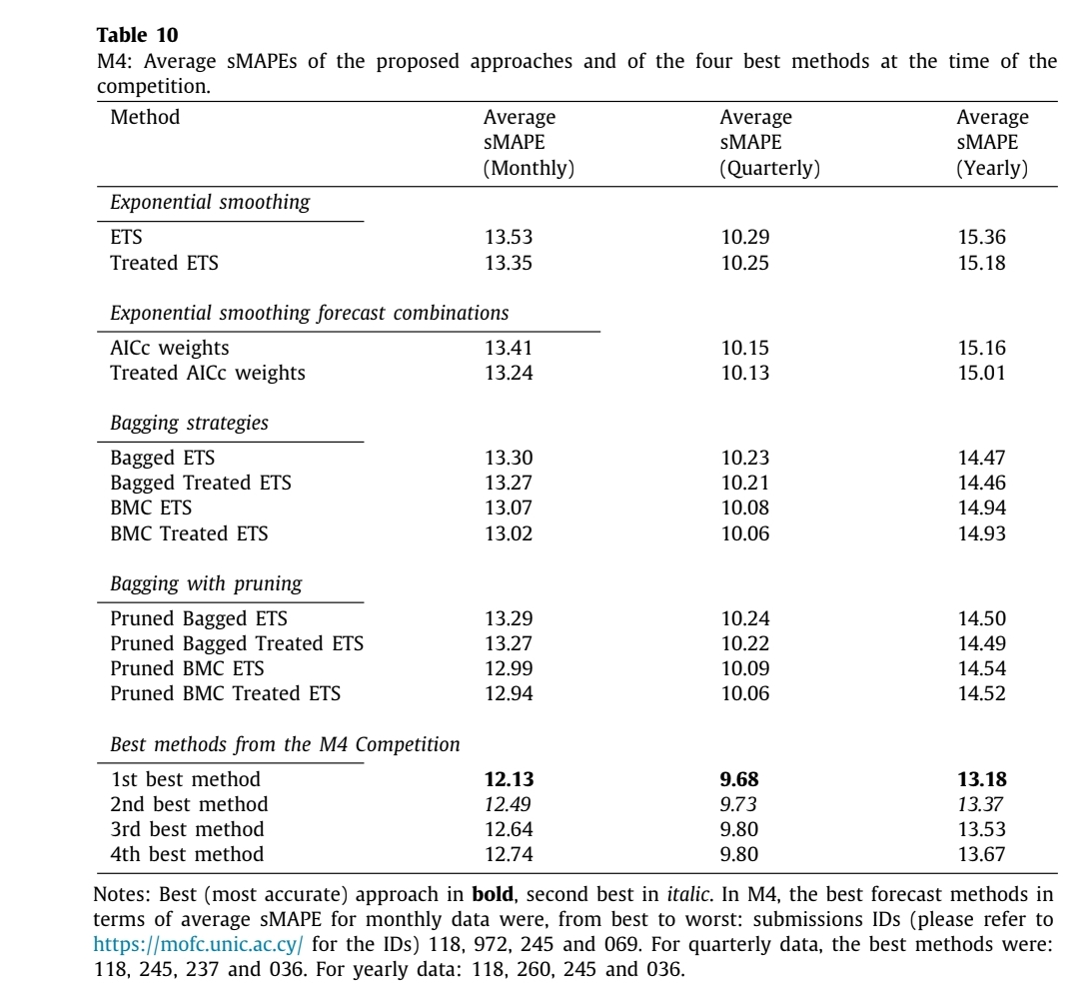

Slide 32
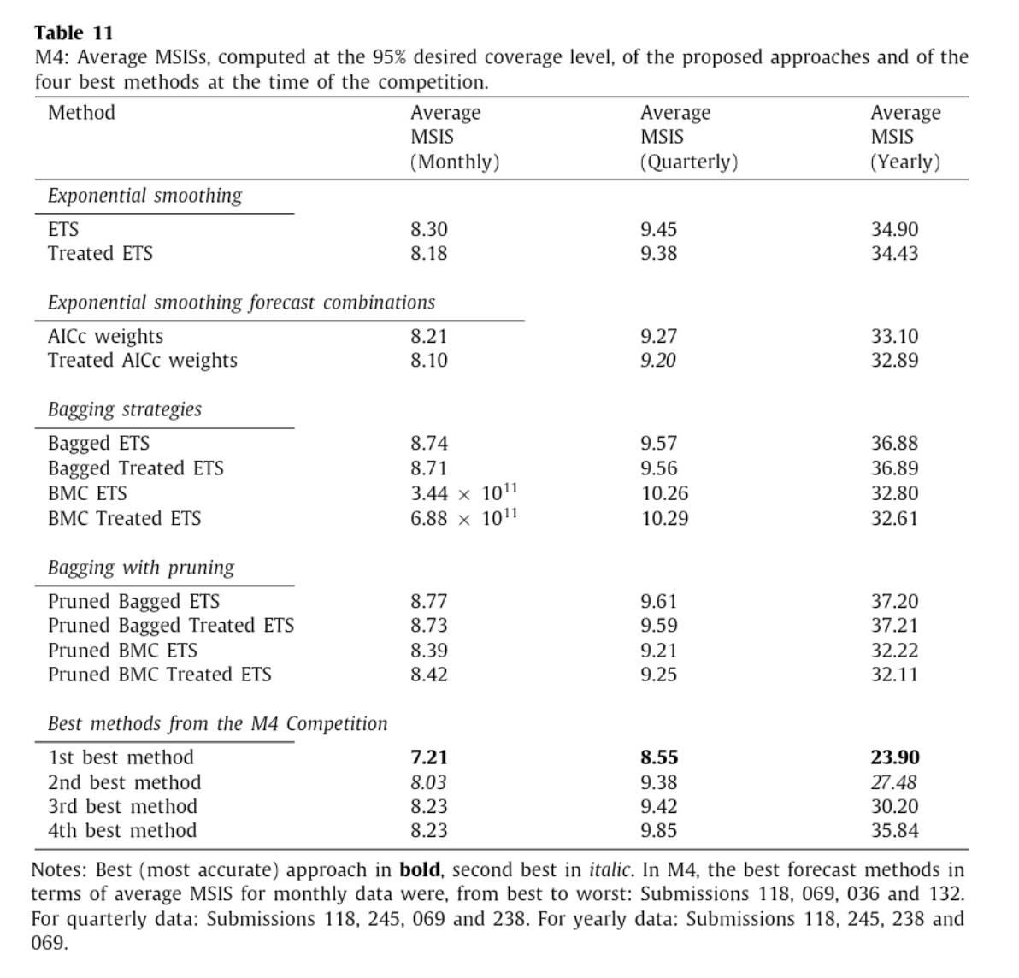

4
3
2
3
4
1
1
1
2
4
2
3

Slide 33
04
Conclusion

Slide 34
Demonstrate that model selection via traditional information criteria minimization may lead to inaccurate forecasts and unstable PIs in some cases.
Show that PIs, apart from providing a convenient way to estimate the uncertainty of a PF, contain important information that can be used to improve the accuracy of forecasting methods.
Based on these two previous findings, they set forth strategies that can be used to improve the accuracy of forecasts for a considerable range of forecast approaches that involve model selection or combination.

Slide 35
Recommending Papers
Exponential smoothing with a damped multiplicative trend
Taylor J.W. 2003
Combining exponential smoothing forecasts using akaike weights
Kolassa S. 2011
Automatic time series forecasting: The forecast package for R
Hyndman R.J., Khandakar Y. 2008

Slide 36
Point and interval forecasting of electricity supply via pruned ensembles
Erick Meira,Fernando Luiz Cyrino Oliveira,Lilian M.de Menezes 2021
The Wisdom of the Data: Getting the Most Out of Univariate Time Series Forecasting
Fotios Petropoulos and Evangelos Spiliotis 2021
Forecast Selection and Representativeness
Fotios Petropoulos , Enno Siemsen 2022

